Slide 1
Vegetation Index Focus Area
Tomoaki Miura & Else Swinnen
Activity Summary and Strategic Plan for 2021-2023

Slide 2
Activities: 2019-2021
Product list updated
Website updated
Publication on VI validation methods
Publication on inter-comparison methods
Draft outline of VI Best Validation Practice Document
2 meetings to finalize this draft
Set up of Teams project to share the document
Also solicit VI requirements

Slide 3
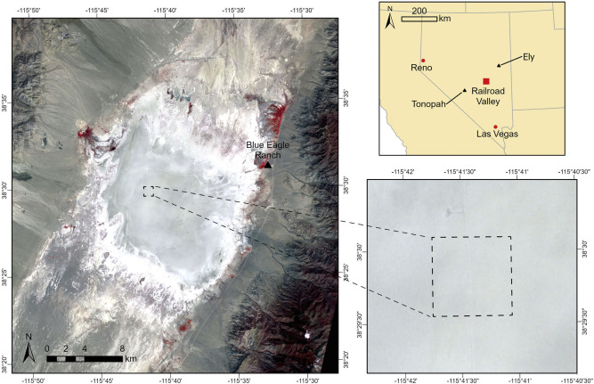
Activities
MODIS and VIIRS VI validation for “zero” vegetation conditions (Miura et al., RSE, 2021, 257, 112344)
MODIS/VIIRS and Advanced Himawari Imager cross-comparison (Miura et al., Scientific Reports, 2019, 9, 15692; Tran et al., Remote Sensing, 12, 2494)

Slide 4
Activities
LSA-SAF
ENDVI validation (NDVI 1km, Metop-A/B AVHRR) (Q4/2019)
CGLS
NDVI 1km V3 validation (BRDF-normalized NDVI 1 km, SPOT/VGT + Proba-V, SRF harmonized) (Q1/2020)
NDVI 300m V2 validation (BRDF-normalized NDVI 300m, S3) (Q2/2021)
Proba-V mission
Validation of Proba-V C2, incl. NDVI (ongoing)
Terrascope
Validation of NDVI (S2, Europe only) (Q3/2020)
HR-VPP (CLS)
Validation of NDVI and PPI (S2, Europe only) (ongoing)

Slide 5
Plan for VI Best Validation Protocol Document
Activity | Tentative Deadline
Add more contents to the outline (VI co-leads) | End of June 2021
Solicit a small group of VI experts Expand the contents/draft Finalize the outline | Mid-September 2021
Inputs from wide VI community | November 2021
Discuss inputs with community (iterative process) | December 2021-January 2022
Summarize the community inputs and update the document | February 2022
Hold a workshop to consolidate the document | April-May 2022
Final approval of the VI validation protocol | June 2022

Slide 6
Strategic Plan for 2021-2023
VI validation protocol document development: Q2/2022
3rd VI workshop: Q2/2022
Paper on VI product intercomparison: Q4/2021

